Slide 1

Spring Data JPA
INCONCEPT LABS LEARNING SERIES

Slide 2
Agenda
What is JDBC ?
What is an ORM ?
Spring Data JPA specification
JPA/Hibernate quickstart

Slide 3
What is JDBC ?
JDBC (Java Database Connectivity) - API in Java that enables applications to interact with databases. It allows a Java application to connect to a database, execute queries, and retrieve and manipulate data. By providing a standard interface, JDBC ensures that Java applications can work with different databases like MySQL, PostgreSQL, and more.

Slide 4
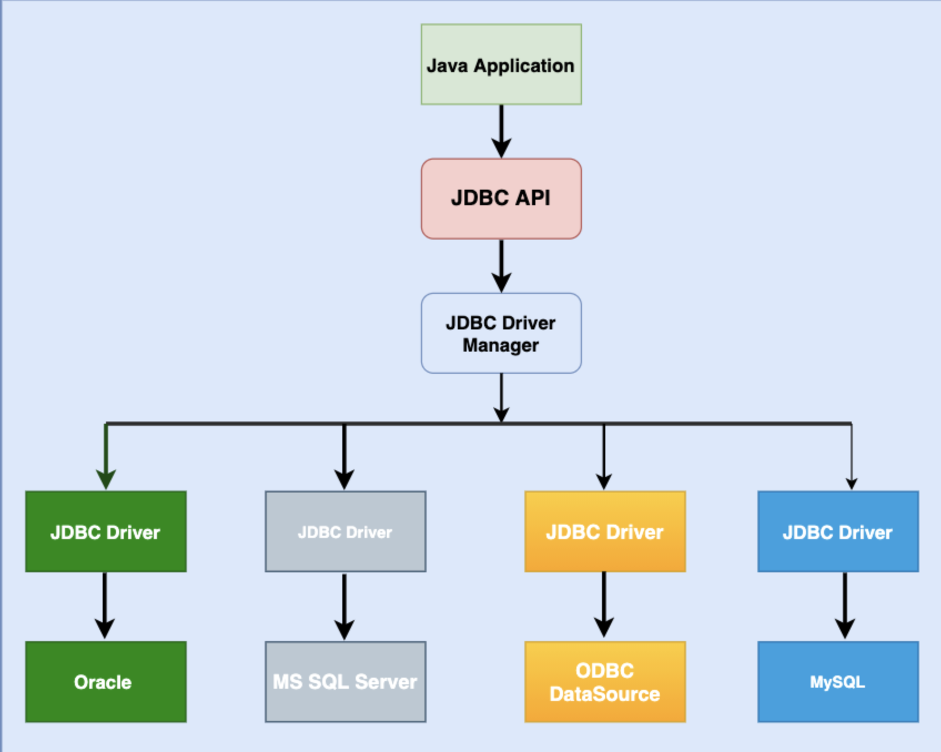
JDBC Architecture

Slide 5
JDBC Main Components
DriverManager - Manages JDBC drivers and establishes database connections.
Driver - A JDBC API implementation used for connecting to a particular type of database.
Connection - Represents a connection with a specific database.
Statement - Used to execute queries.
ResultSet - Represents the result set of a query, allowing navigation through the rows.

Slide 6
JDBC Drawbacks
Boilerplate Code - Requires extensive, repetitive code for database operations.
Manual Mapping - You must manually map database rows to Java objects.
Database Specific SQL - Queries are often tailored to a specific database, reducing portability.
Transaction Management - Requires explicit handling of transactions, commits, and rollbacks.
Error Handling - Requires manual exception handling for database-related issues.

Slide 7
What is an ORM ?
Object-relational mapping is responsible for managing the conversion of software objects to interact with the tables and columns in a relational database.
Instead of defining how objects are saved and retrieved, you define the mapping between objects and your database, then invoke ORM to persist them.
Use ORM but keep in mind:
Design your queries and write code that will result in the least number of roundtrips with the server. It's the overhead taken for the roundtrip that takes up time.
ORM has a tendency to be slow but delay loading and some smart options can make it almost as fast
Always compare your queries with the actual ones being executed in SQL server profiler.

Slide 8
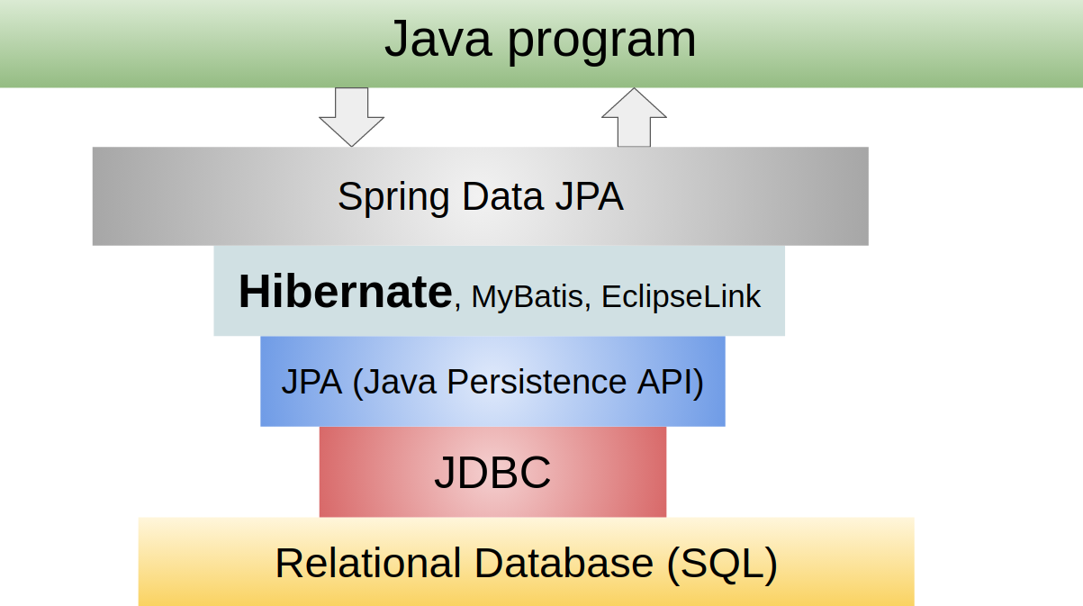
Spring Data JPA
The Java Persistence API is a specification, not an implementation, it defines a common set of concepts that need be implemented by ORM tools.
As a spec, JPA provides metadata annotations, which you use to define the mapping between objects and the database.
There are multiple JPA implementations like
Hibernate
EclipseLink
Apache OpenJPA
etc.

Slide 9
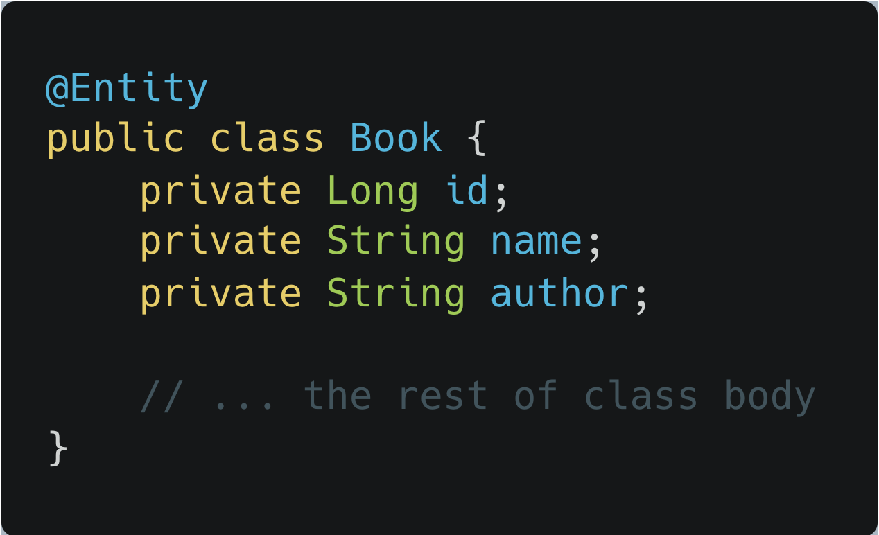
JPA @Entity annotation
Attaching @Entity to a class informs JPA that this class and its objects should be persisted.
By default, this entity will be mapped to the Book table, as determined by the given class name.

Slide 10
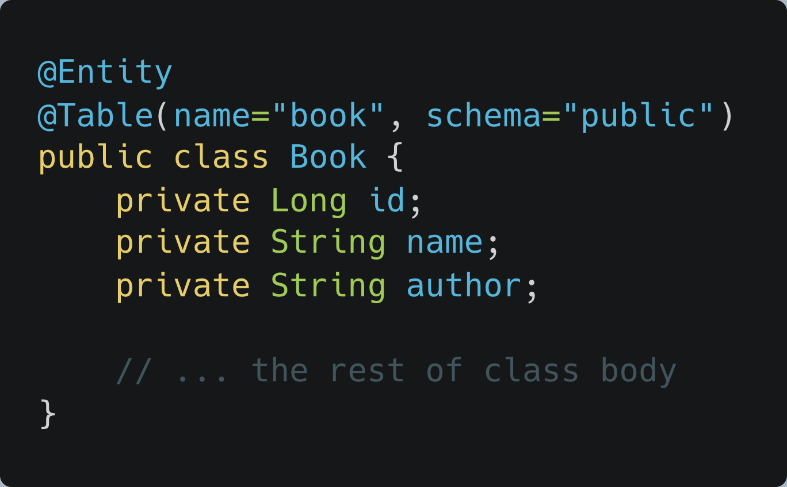
JPA @Table annotation
Attaching @Table to a class tells JPA to persist the entity (Book class) to the book table and public schema.

Slide 11
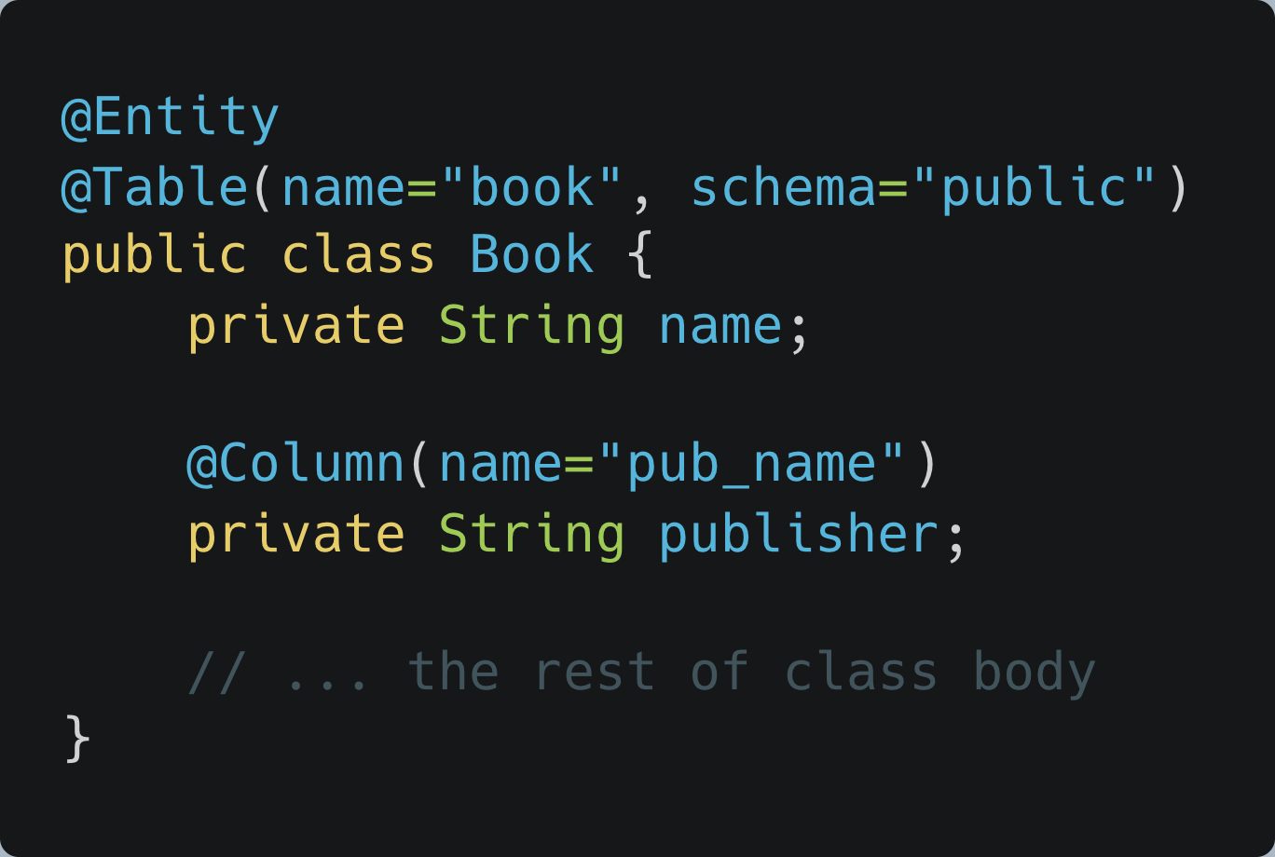
Mapping fields to columns
Fields are defined as member variables in the class, with the name of each field being mapped to a column name in the table.
You can override this default mapping by using the @Column annotation.
The @Column annotation allows us to define additional properties of the field/column, including length, whether it is nullable, whether it must be unique and so forth.

Slide 12
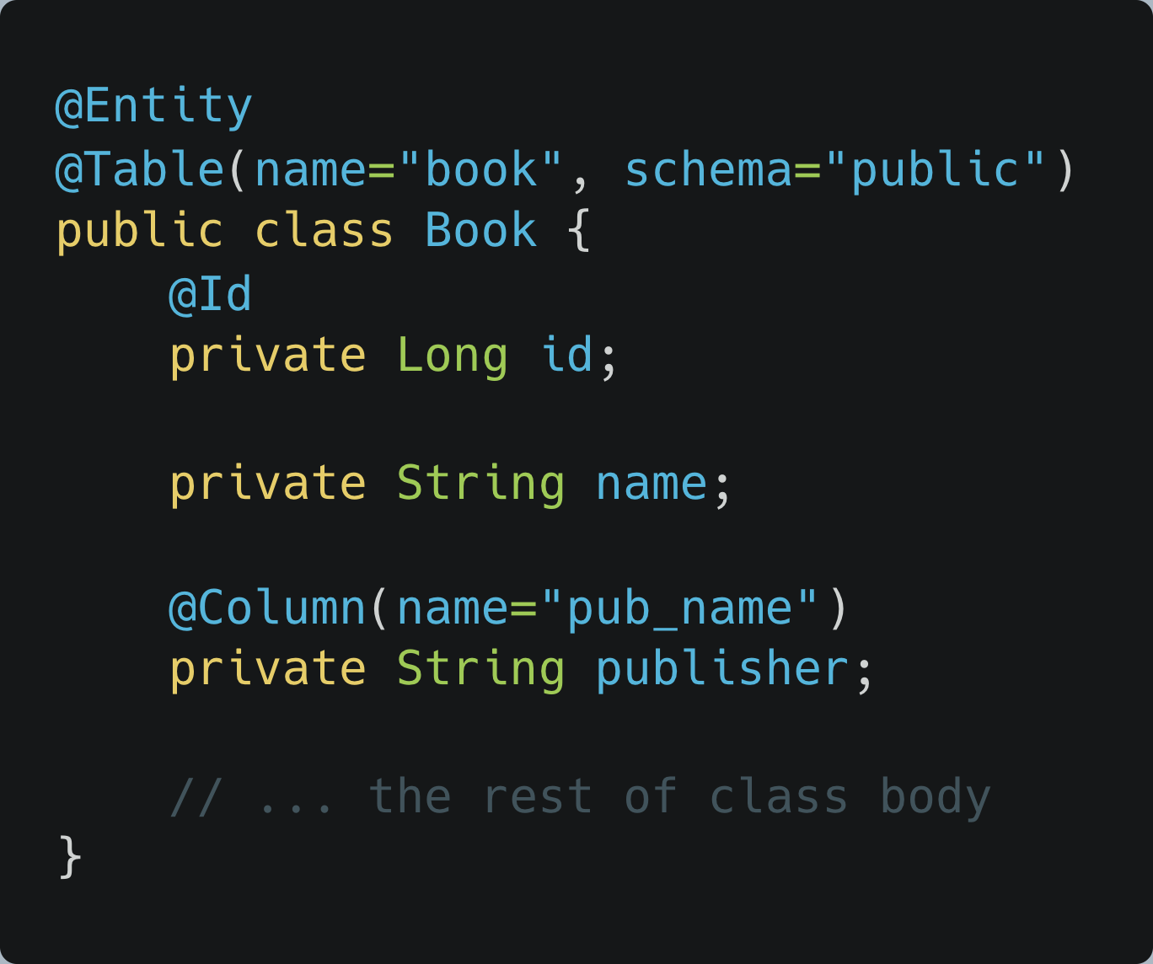
Specifying the primary key
We use the @Id annotation to designate a field to be the table's primary key. It is possible to combine the @Id annotation with the @Column annotation to overwrite the primary key's column-name mapping.

Slide 13
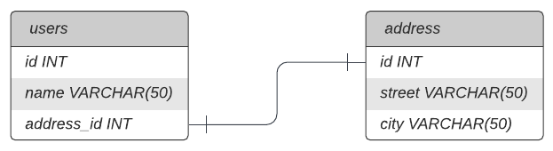
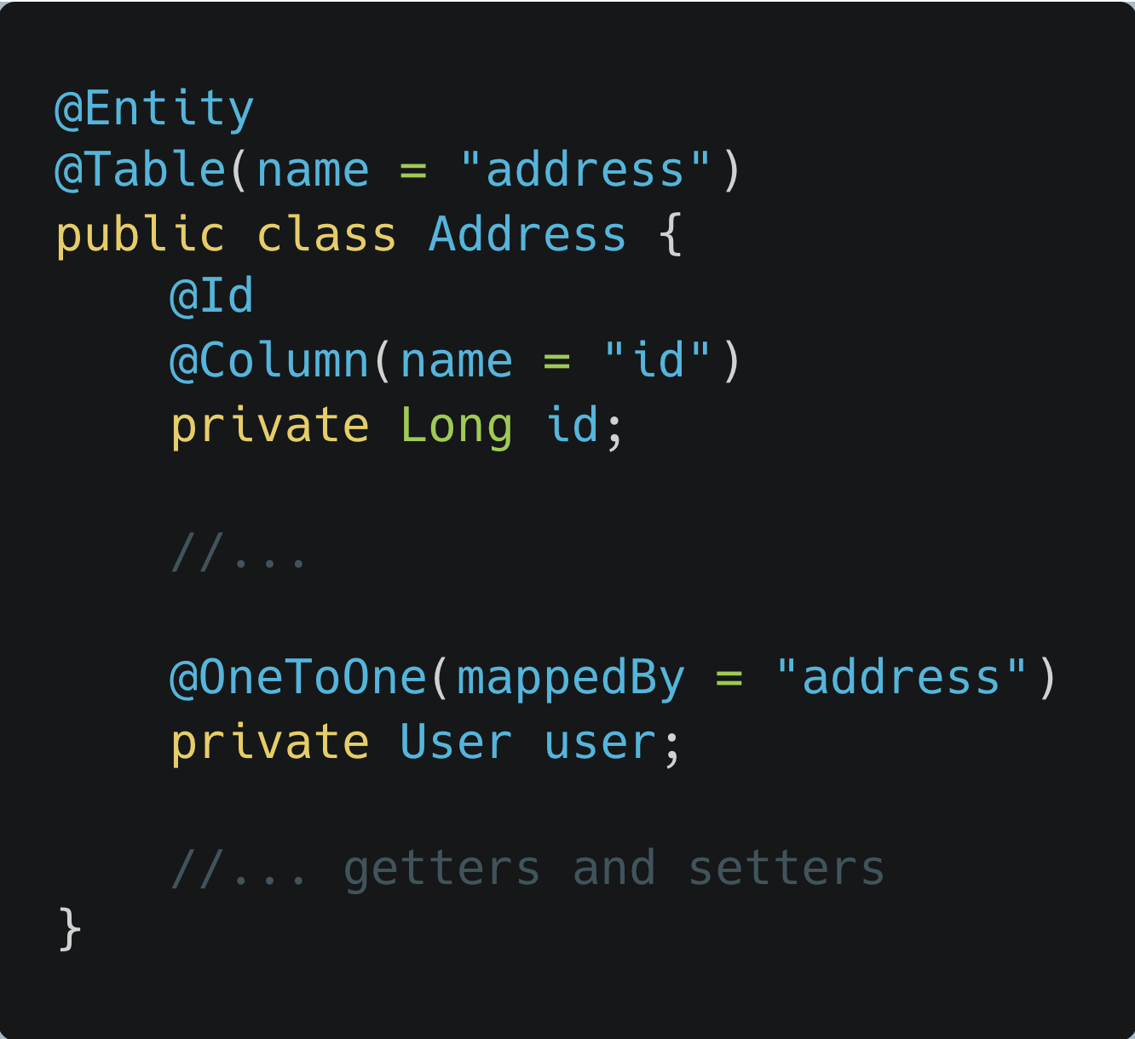
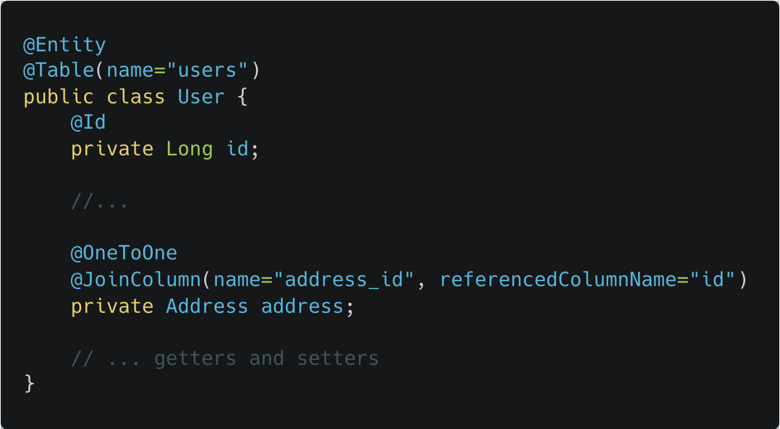
@OneToOne relationship

Slide 14
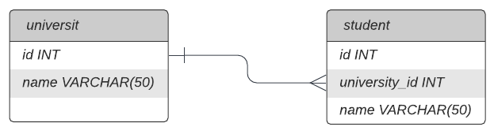
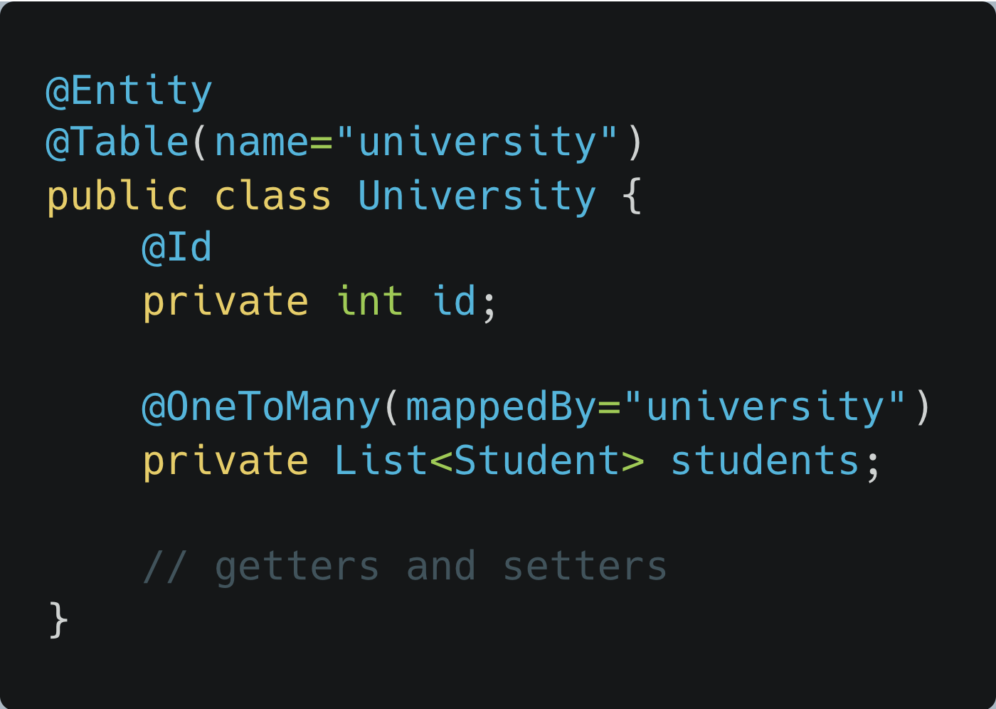
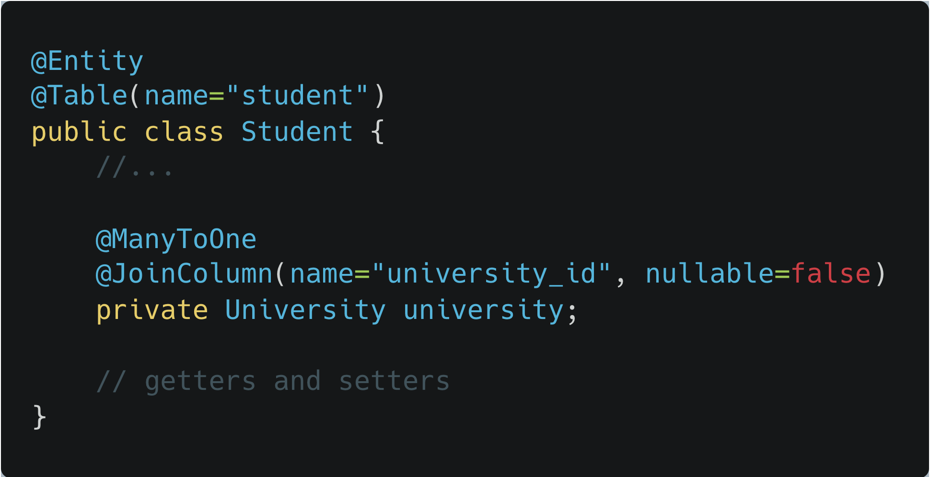
@OneToMany and @ManyToOne

Slide 15
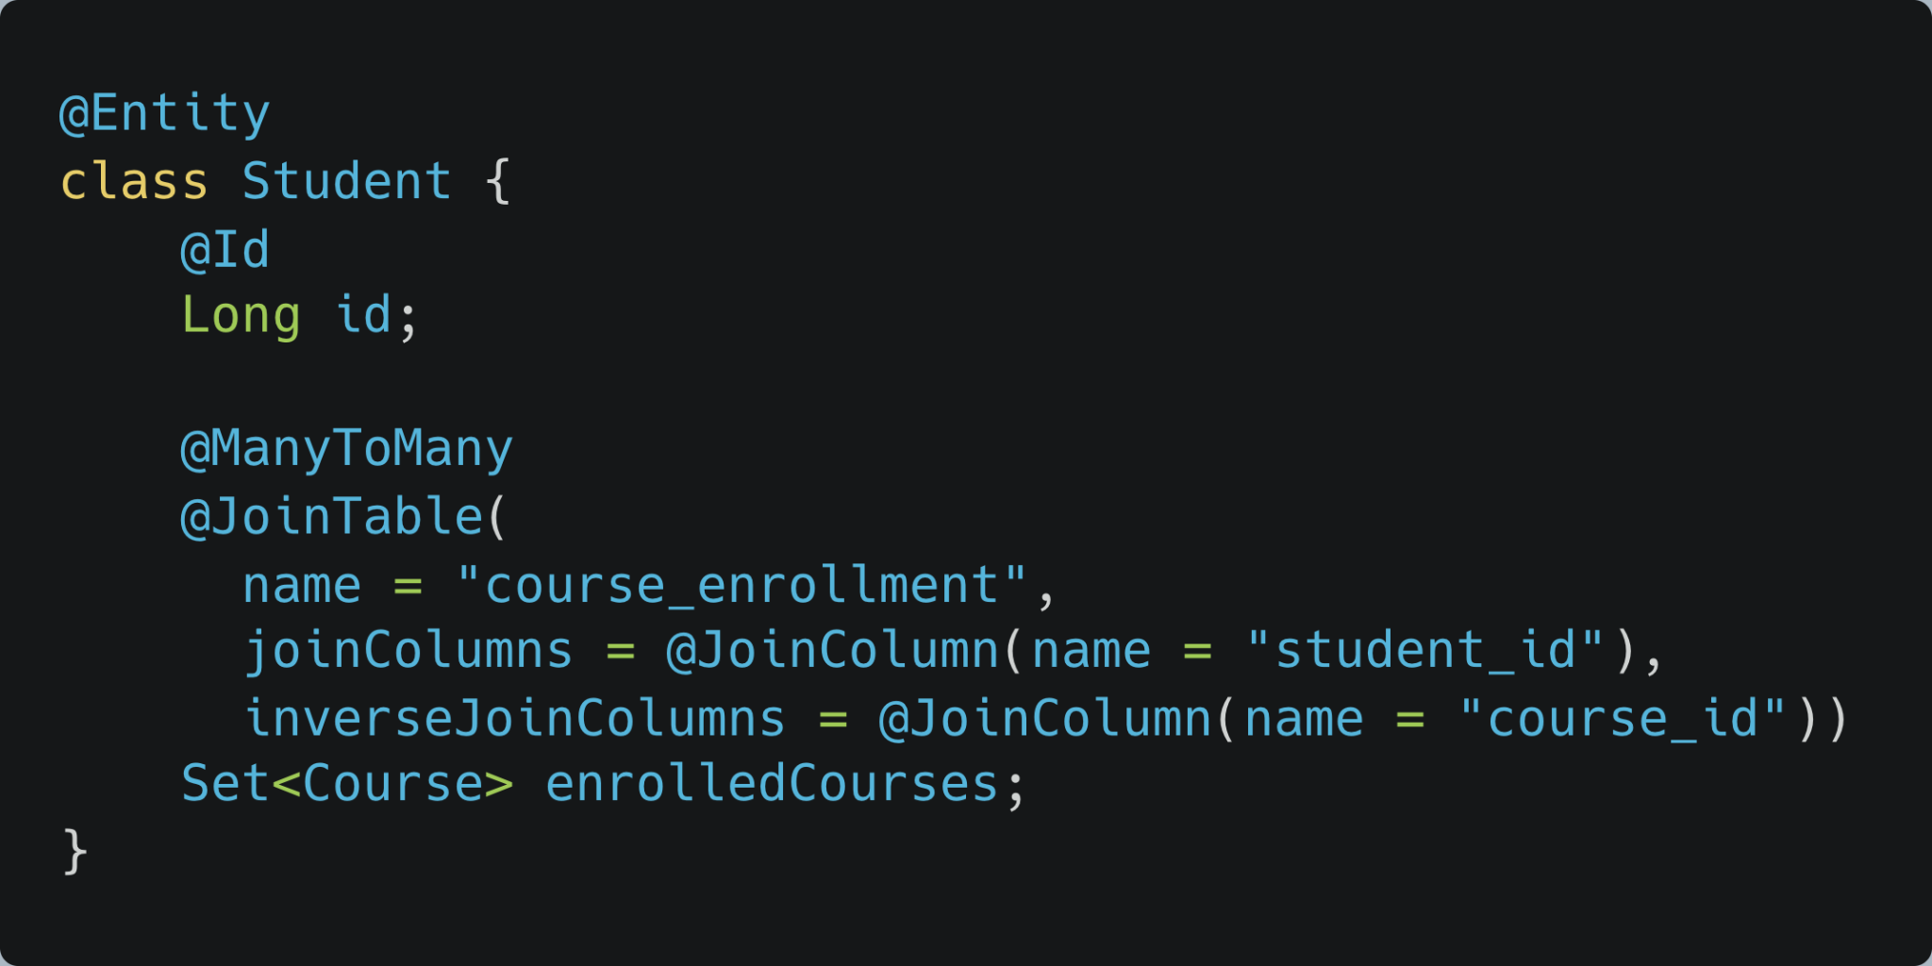
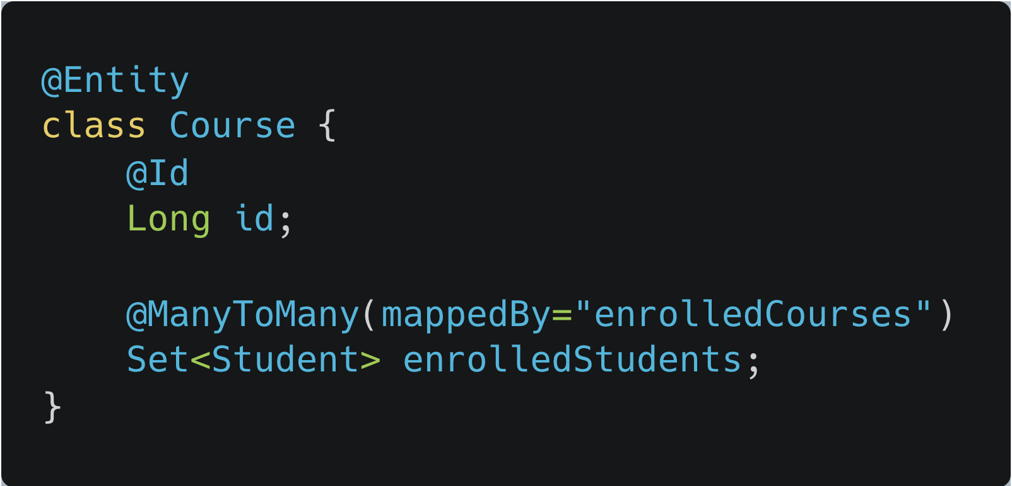
@ManyToMany relationship

Slide 16
Eager and Lazy Loading
Fetching strategies tell JPA how to load related entities.
Eager Loading is a design pattern in which data initialization occurs on the spot.
Lazy Loading is a design pattern that we use to defer initialization of an object as long as it's possible.
The main difference between the two types of fetching is the moment when data gets loaded into a memory.

Slide 17
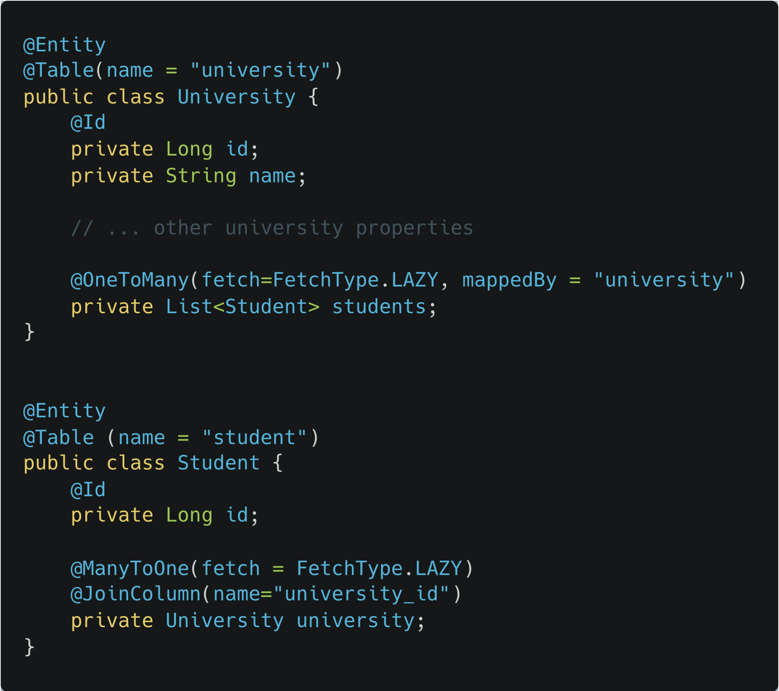
Eager and Lazy Loading
With the lazy initialization approach, students will get initialized only when we explicitly call it, using a getter or some other method. But with an eager approach the students will be initialized immediately in the first line.

Slide 18
Eager and Lazy Loading
Lazy loading
Advantages:
Much smaller initial load time than in the other approach
Less memory consumption than in the other approach
Disadvantages:
Delayed initialization might impact performance during unwanted moments
In some cases we need to handle lazily initialized objects with special care, or we might end up with an exception
Eager loading
Advantages:
No delayed initialization-related performance impacts
Disadvantages:
Long initial loading time
Loading too much unnecessary data might impact performance

Slide 19
Cascade types
Entity relationships often depend on the existence of another entity, for example the Person–Address relationship. Without the Person, the Address entity doesn't have any meaning of its own. When we delete the Person entity, our Address entity should also get deleted.
Cascading is the way to achieve this. When we perform some action on the target entity, the same action will be propogated to the associated entity.
ALL - propagates all operations from a parent to a child entity
PERSIST - propagates the persist operation from a parent to a child entity
MERGE - propagates the merge operation from a parent to a child entity.
REMOVE - propagates the remove operation from parent to child entity. Similar to JPA's CascadeType.REMOVE, we have CascadeType.DELETE, which is specific to Hibernate
REFRESH - When we use this operation with Cascade Type REFRESH, the child entity also gets reloaded from the database whenever the parent entity is refreshed.
DETACH - The detach operation removes the entity from the persistent context. When we use CascadeType.DETACH, the child entity will also get removed from the persistent context.

Slide 20
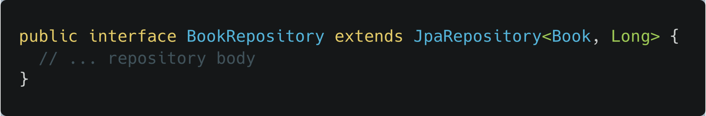
JPA Repository
The goal of Spring Data repository abstraction is to significantly reduce the amount of boilerplate code required to implement data access layers.
JpaRepository is a JPA specific extension of Repository. It contains API for basic CRUD operations and also API for pagination and sorting.

Slide 21
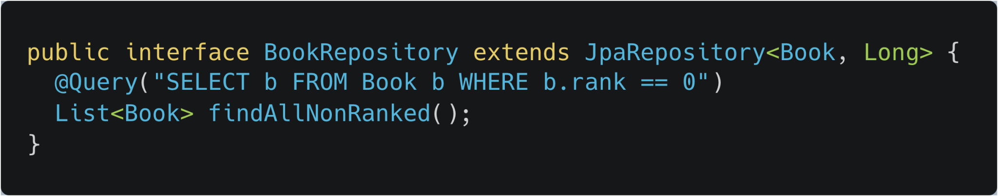
Using @Query
In order to define SQL to execute for a Spring Data repository method, we can annotate the method with the @Query annotation — its value attribute contains the JPQL(Java Persistence Query Language) or SQL to execute.
By default, the query definition uses JPQL.
Let's look at a simple repository method that returns all non ranked books from the database:

Slide 22
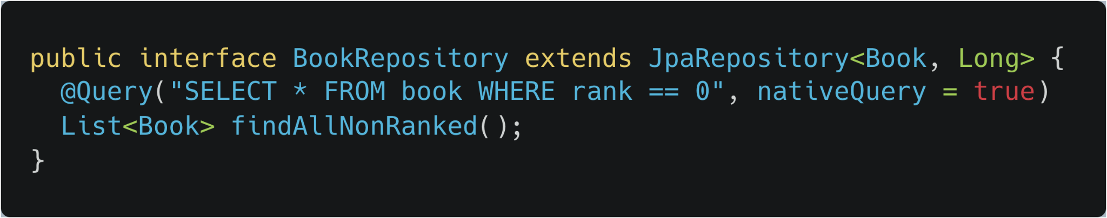
Native @Query
We can use also native SQL to define our query. All we have to do is set the value of the nativeQuery attribute to true and define the native SQL query in the value attribute of the annotation:

Slide 23
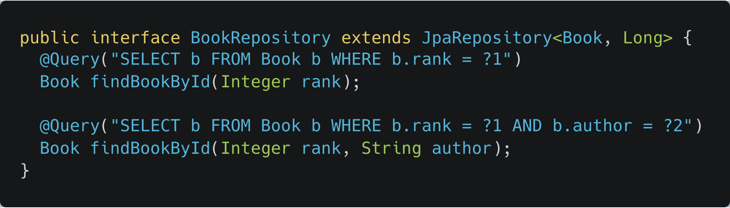
Indexed Query Parameters
For indexed parameters in JPQL, Spring Data will pass method parameters to the query in the same order they appear in the method declaration:

Slide 24
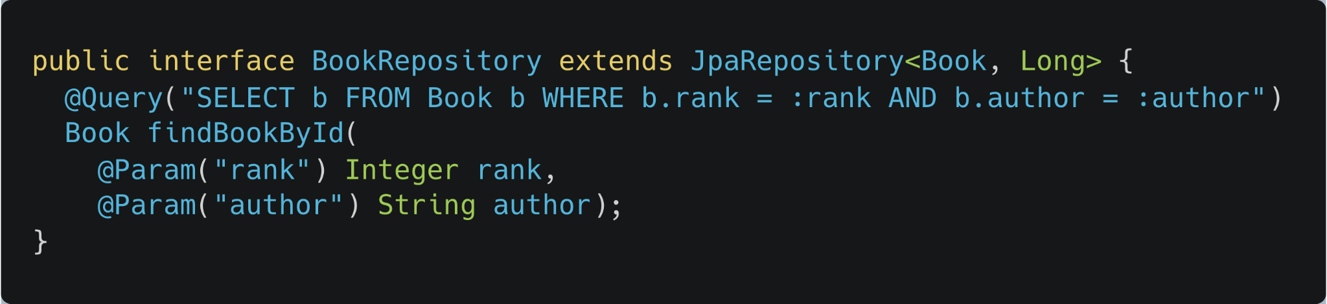
Named Parameters
We can also pass method parameters to the query using named parameters. We define these using the @Param annotation inside our repository method declaration.

Slide 25
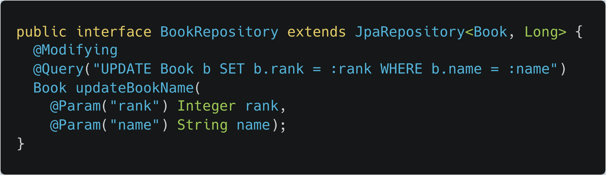
Update Queries With @Modifying
We should use the @Modifying annotation to modify the state of the database in the repository method. The return value defines how many rows the execution of the query updated. Both indexed and named parameters can be used inside update queries.
Note: To perform an insert operation, we have to use a native query since INSERT is not a part of the JPA interface

Slide 26
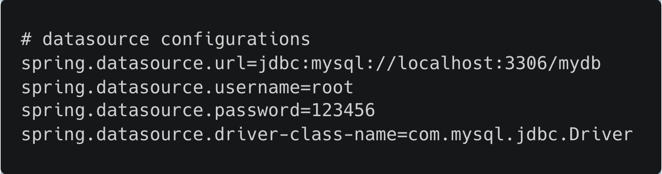
JPA/Hibernate quickstart
Dependencies
spring-boot-starter
spring-boot-starter-data-jpa - will reference all the necessary dependencies such as hibernate-core, spring-data-jpa
mysql-connector-java - or other db connector appropriate to project
Spring Boot configures Hibernate as the default JPA provider. Spring Boot will automatically try to create DataSource if it finds the if spring-data-jpa in the class-path. It will try to read the database configurations from the application.properties file.
Let’s add the database configuration to our application.properties

Slide 27
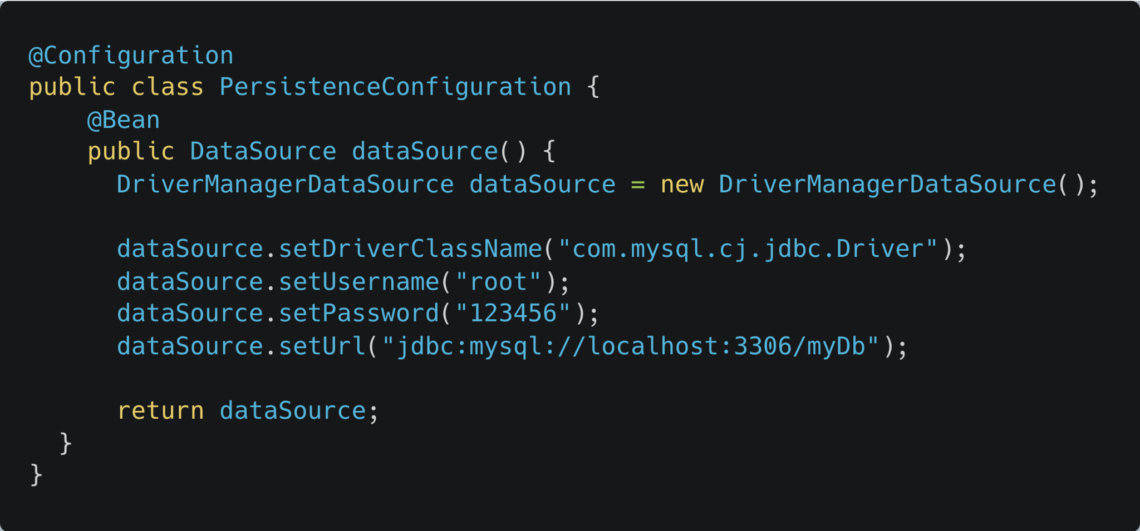
JPA/Hibernate quickstart
We can create a custom DataSource as well and Spring will use that instead of application.properties configuration

Slide 28
Thank you

